Slide 1

Welcome to St Michael’s
11th Sunday in Ordinary Time Year C
Are you new to our Parish? Welcome!
Please make yourself known to the priest, or email the parish or write your name and contact details on the form provided at each of the church doors.
Please ensure all mobile phones are switched off.
Please be respectfully quiet as we prepare for our Celebration.
Notes:
Saturday 5.30PM First Sunday of Advent
7am - 7th Sunday in Ord Time Year B

Slide 2
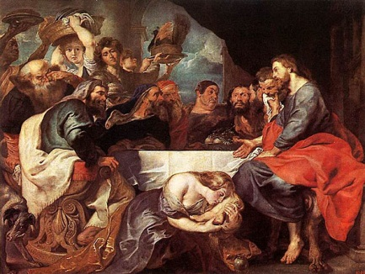
When Jesus arrived at the Pharisee’s house and took his place at table, a woman came in, who had a bad name in the town…

Slide 3
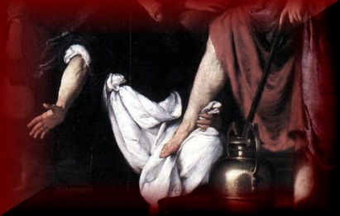
She had heard he was dining with the Pharisee and had brought with her an alabaster jar of ointment.

Slide 4
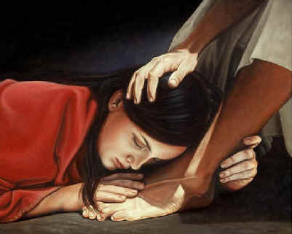
…weeping, and her tears fell on his feet, and she wiped them away with her hair;

Slide 5

Am I willing to reach out to all with humility and generous compassion?

Slide 6
PLEASE STAND

Slide 8
Gloria
Glory to God in the highest,
and on earth peace to people of good will.
We praise you, we bless you, we adore you,
we glorify you,

Slide 9
we give you thanks for your great glory,
Lord God, heavenly King,
O God, almighty Father.
Lord Jesus Christ, Only Begotten Son,
Lord God, Lamb of God, Son of the Father,

Slide 10
you take away the sins of the world, have mercy on us;
you take away the sins of the world, receive our prayer;
you are seated at the right hand of the Father,
have mercy on us.

Slide 11
For you alone are the Holy One,
you alone are the Lord, you alone are the Most High, Jesus Christ, with the Holy Spirit, in the glory of God the Father. Amen.

Slide 13
RESPONSORIAL PSALM
Lord,
forgive the wrong I have done.

Slide 15
GOSPEL ACCLAMATION
Alleluia, alleluia!
God first loved us and sent his Son to take away our sins.
Alleluia!

Slide 17
First Collection
This collection goes to the Bishop
for the support of the Diocese.
Thank you for your contribution

Slide 19
Apostles Creed
I believe in God,
the Father almighty,
Creator of heaven and earth,
and in Jesus Christ, his only Son, our Lord,
(At the words that follow, up to and including the Virgin Mary, all bow.)

Slide 20
who was conceived by the Holy Spirit,
born of the Virgin Mary,
suffered under Pontius Pilate,
was crucified, died and was buried;
he descended into hell;

Slide 21
on the third day he rose again from the dead;
he ascended into heaven,
and is seated at the right hand of God the Father almighty;
from there he will come to judge the living and the dead.

Slide 22
I believe in the Holy Spirit,
the holy catholic Church,
the communion of saints, the forgiveness of sins,
the resurrection of the body, and life everlasting. Amen.

Slide 24

VINNIES ANNUAL
WINTER APPEAL
Please give generously envelopes available should you wish to donate by Credit Card or require a receipt.

Slide 26
All: May the Lord accept the sacrifice
at your hands for the praise and glory of his name, for our good and the good of all his holy Church.

Slide 28
HOLY, HOLY, HOLY
Holy, Holy, Holy Lord God of hosts,
Heaven and earth are full of your glory. Hosanna in the highest
Blessed is he who comes
in the name of Lord,
Hosanna in the highest.

Slide 30
Memorial Acclamation
We proclaim your Death, O Lord,
and profess your Resurrection
until you come again.
Notes:
Sunday 10AM First Sunday of Advent
7am - 14th Sunday in Ord Time
7am - 14th Sunday in Ord Time

Slide 32
Lamb of God
Lamb of God, you take away the sins of the world, have mercy on us.
Lamb of God, you take away the sins of the world, have mercy on us.
Lamb of God, you take away the sins of the world, grant us peace.

Slide 34
All: Lord, I am not worthy
that you should enter under my roof, but only say the word
and my soul shall be healed.

Slide 37
Second Collection
What you contribute now
is for the support of our
parish and its mission.
Thank you for your generosity

Slide 38
Parish Pastoral Council (PPC)
The next general meeting of the PPC will be held on Tuesday, 18 June at 7.30pm in the Parish Centre.
The Executive Committee of the incoming PPC will be elected at that meeting.
Minutes from the St Michael’s PPC 2013 AGM are now available on the church noticeboard should anyone wish to view them.

Slide 39
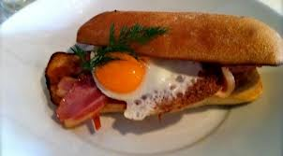
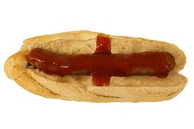

VINNIES BBQ
After 8am & 9.30am Masses this weekend there will be a BBQ of Bacon, Eggs & sausages, for sale (All monies to go towards the Saint Vincent De Paul Winter appeal).

Slide 40

MUSIC WORKSHOP
ST PATRICK’S PRIMARY SCHOOL MULTIPURPOSE AREAA
23 June from 11.00am
rsvp: judith@stpatricksparish.org.au
St Michael’s Parish Office 96 22 9149
St Patrick’s Parish Office 96 22 1125

Slide 41

Are you new to our Parish?
Speak with one of our priests;
Email the Parish Office
Write name and contact details on forms at church doors.

Slide 42
Please take home your bulletins or download it from
www.stmichaelsparish.com

Slide 44
Am I willing to reach out to all with humility and generous compassion?

